Slide 1
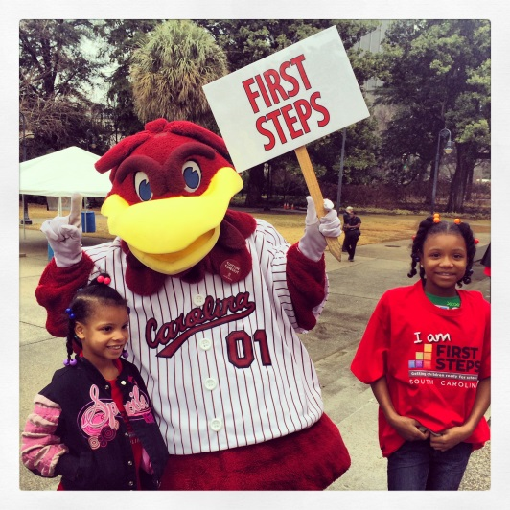
March Leadership
Webinar
March 22, 2016 10:00-11:00 AM
To access this meeting by voice, please dial 888-537-7715,
participant code 52045398#

Slide 2
Today’s Agenda
Welcome and Introductions
Legislative Update
FY 17 Renewal Plan Template
Strategy Self Assessment Checklists
Local First Steps Teams
Local ED and Staff Orientation Materials
Program Updates
4k
Baby Net
Early Head Start
Announcements and Key Dates

Slide 3
Legislative Update
Reauthorization Bill
House Ways and Means
Senate Budget Committee
House Oversight Committee

Slide 4
FY 17 Partnership & Program Accountability Standards
Final Version as adopted by State Board posted to website

Slide 5
FY17 Renewal Plan Template
Table of Contents
Cover Signature Page
Required Attachments Checklist
Partnership Needs and Resources Assessment
State Strategic Plan Priorities
Guidance on use of FY17 Funding
Program Standards Section:
*Discontinued Strategies
FY17 Strategy Summary
*FY16 Performance Summary: Continuing Strategies (update on FY16 Priority Goals/Obj if applicable)
*Addendum for “Other” and Community Education Continuing Strategies
FY16 Child Care Training Summary
*New Strategies
Partnership Standards Section:
Update on FY16 Priority Goals and Objectives
Core Functions and Community Engagement
Governance
Board Members List
Resource Development
DRAFT Priority Goals and Objectives for FY17
Fiscal Signatories Form for FY17
*copy/paste for each applicable strategy
Excel Spreadsheet (2 tabs): Proposed use of Carryforward and Reduction in Funding

Slide 6
Strategy Self Assessment Checklists
For each program standard and “Other” strategies
Posted to the web site under Partnership Resources/Accountability
Use to report on strategy successes, as well as challenges/compliance issues, in the Renewal Plan
TA Team resource for strategy reviews

Slide 7
Time Line
March 21 – Renewal Plan Application released
May 6 – Renewal Plans due to state office
May 20 – TA’s complete reviews and get initial feedback to counties
May 27 – TA’s meet to finalize recommendations
June 1 – Final data deadline, P&G Committee meeting materials sent out
June 8 – P&G Committee meets
June 16 – State Board meets
June 30 – Feedback on Priority Goals for FY 17 sent out to counties (due back Sept. 30)

Slide 8
Local First Steps Teams
Members include:
Executive Director (convener)
4K Regional Coordinator for the county,
BabyNet Supervisor for the county
Representative for Early Head Start
State Office Technical Assistant for the Local Partnership

Slide 9
Local First Steps Teams
Purpose:
Improve communications between each partnership and First Steps’ state-level programs
Establish the statutory convener role of each local Executive Director
Develop shared opportunities to improve all First Steps Programs operations and services in a community
Develop additional accountability between all First Steps operations

Slide 10
Local First Steps Teams
To acknowledge contributions of local partnerships a percentage of the total state program service expenditures in each county will be credited to the Local Partnerships’ budgets.
A minimum credit of $3,500 in administrative budget will be applied.
This proposal will not transfer any funding to the partnerships but will credit them with a portion of state level expenditures, increasing the amount they can spend on Administration, while staying under the 8% cap.
If the number of children served is increased, the next year, the local partnerships will benefit, as this credit will be adjusted annually.

Slide 11
Local Board/ED Orientation Materials
Purpose: comprehensive and easily accessible way to onboard new local partnership EDs, staff, and board members
Three, 30-45 minute training “modules” in the form of PowerPoint presentations with accompanying guided notes for facilitator:
Module 1: What is First Steps?
Module 2: Local Partnership Structure & Functions
Module 3: Local Partnership Systems & Accountability Overview
Modules will be posted for EDs to review (link to be sent out).

Slide 12
4K Update
The application for new centers for 16-17 is on our website. We appreciate referrals from our EDs! Our Regional Coordinators are in the process of contacting all EDS of current counties for updates on service.
Renewed 4K centers have received the student application for 16-17. Please share the information for all choices of 4K in your county.

Slide 13
4K Territories:
Barbara Black- Chester, Kershaw, Richland, York
Sharon Bruton- Anderson, Cherokee, Oconee, Pickens, Spartanburg, Union
LaDrica Christian- Darlington, Dillon, Florence, Lee, Marlboro, Williamsburg
Kristine Jenkins- Horry, Marion
Cassandra Johnson - Barnwell, Bamberg, Calhoun, Laurens, Sumter
Joy Mazur- Beaufort, Berkeley, Clarendon, Dorchester, Georgetown, Hampton, Jasper, Orangeburg
Marley Via – Aiken, Edgefield, Greenwood, Lexington, Newberry, Saluda

Slide 14
Early Head Start Update
Processed New Hires for Starting by April 4
Fiscal Manager
Family Services/ERSEA Manager
Education Coordinators - Berkeley and Columbia
Health Coordinator
Submitted following positions for posting: (jobs.sc.gov)
Family Advocates (Human Services Specialist II) (8)
Program Assistant (Administrative Coordinator II)
Initiated Recruitment for families of Infants and Toddlers this Spring at the first four sites.
Advertised and worked on selection of vendors to prepare remaining EHS classrooms and to install New 0-3 year old playgrounds
Began Writing Family and Community Partnership/ERSEA Policies and Procedures and the Refunding EHS-CC Partnership application.

Slide 15
BabyNet Update
BabyNet positions are being filled in 5 of 7 BabyNet Districts – of 18 positions 16 have been filled (Florence and Sumter still hiring)
Public Hearings for Policy revisions begin this week – details on First Steps Website
BabyNet increased budget request moving through legislative process
Christie Duke at 803-734-4713 or Janice Kilburn 803-730-3084

Slide 16
ANNOUNCEMENTS
CTK Teacher Training
SCANPO Board Summit and Wednesday Webinars
ED May Meeting?

Slide 17
Key Partnership Dates
April 14: South Carolina READ IN / ED meeting following
April 19: Partnership Monthly Webinar
May 2nd – 5th : Smart Start Conference
May 6: Renewal Plans Due
May 17: ED Meeting or Webinar?
June 16: State Board of Trustees Meeting
July 15: PAT – APR’s due

