Slide 1
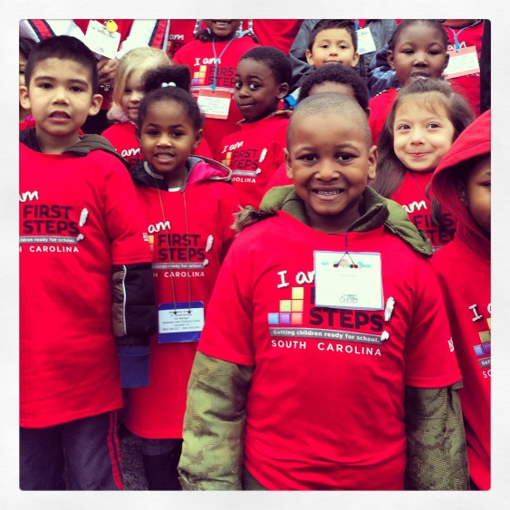

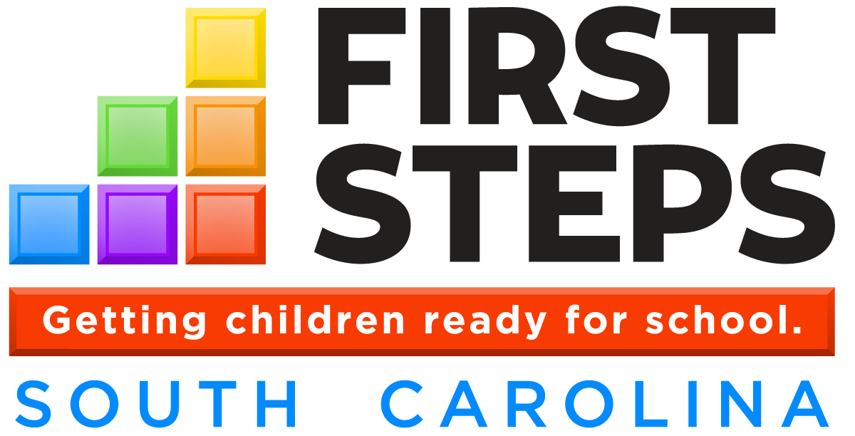
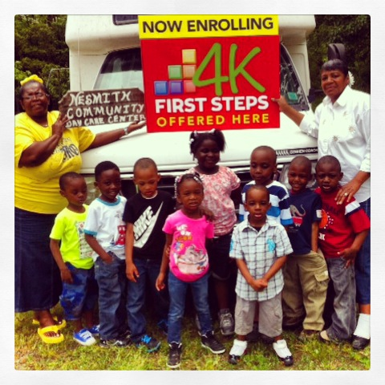
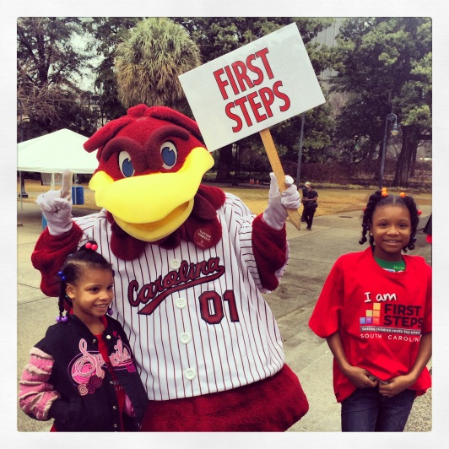
Local Partnership Orientation Training
Orientation: What is SC First Steps?
Notes:
Facilitator Note: This training was designed by the state office of First Steps in collaboration with current First Steps Executive Directors. It synthesizes many existing First Steps resources with the audience of new local partnership staff and board members in mind. Participants and facilitators are welcome to visit the SC First Steps website (www.scfirststeps.com) to access all of the resources that are referenced in this training and learn more about the topics presented.
Estimated time needed to complete training – 45 minutes

Slide 2
Training Modules for SC First Steps Local Partnership Orientation
Module 1: Orientation - What is SC First Steps?
Module 2: Local Partnership Structure & Functions
Module 3: Local Partnership Systems & Accountability
  Supplemental Systems & Accountability Modules
Your SC First Steps Partnership
Notes:
Explain:
This slide lays out the training modules for new local partnership staff and board members.
This module is the first of a training series for all new local partnership staff, including executive directors, and local board members. The two 30 minute modules that follow this Orientation will take participants through a general overview of the key aspects of a local SC First Steps (FS) partnership, including information on the structure of the FS state office and local partnerships, an explanation of the roles and responsibilities of executive directors and local board members, and general information on the current standards and systems that are in place to ensure local partnerships run smoothly and effectively. These modules are supplemented by several short trainings that take deeper, more in-depth looks at several important areas of local FS partnerships, including systems and accountability tools.
This training program is designed to introduce participants to their new role as SC First Steps local partnership staff and board members. Additional resources and supports will be available in your Orientation Materials Handbook accompanying this training and on the SC First Steps website at www.scfirststeps.com under the tab for “Local Partnerships”.

Slide 3
Agenda
Context – Why is investing in the earliest years important?
What is SC First Steps?
History of SC First Steps
Legislative Goals
SC First Steps Structure
  Duties of the SC First Steps Office
  Duties of Local Partnerships
SC First Steps Core Areas of Service & Programs
Notes:
Facilitator Note: Briefly review agenda.
Facilitator Note: It is recommended to deliver the presentation either a) without taking questions during the presentation, but allowing significant time for questions after the presentation, or b) by stopping to take questions at strategic times during the presentation, and also allowing questions at the end of the presentation.

Slide 4
Intended Outcomes
Participants will have a basic understanding of SC First Steps, including:
  The context and history of SC First Steps
  The legislative goals of SC First Steps
  Local and state SC First Steps structure
  Core areas of service and programs
Notes:
Facilitator Note: Briefly review intended outcomes.

Slide 5
Documents Referenced in this Training
Please find the following document in your Orientation Materials Packet:
First Steps Reauthorization – Act 287 of 2014

Slide 6
Context – Why is investing in the earliest years so important?
Research has proven that the earliest years of life – prior to school entry – are the most critical years for brain development. In fact, 90% of brain development occurs before age 5.
Studies show that positive early experiences for young children help shape their long-term success, while also saving taxpayer dollars in long-term education and social impact costs.
Notes:
Explain:
Although research has shown that 90% of the brain’s full potential is formed by age five, 90% of education spending occurs after age five. This paradigm must be changed if we want to make significant progress in reducing the achievement gap for disadvantaged children.
We know that providing what Nobel Prize-winning economist James Heckman calls a “scaffolding of support” - strong families, quality early education, health and nutrition – promotes the “enhancers” and minimizes the “reducers” that change children’s brains. According to Heckman, this scaffolding of support leads to a 7 to 10 percent per year return on investment in terms of increased school and career achievement and lower social costs in remedial education, health and criminal activity (Heckman, 2008).

Slide 7
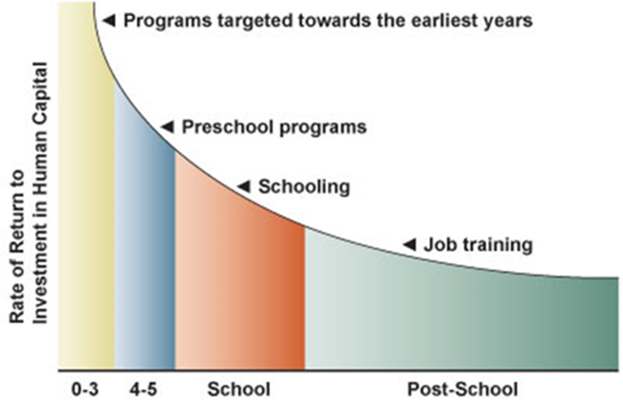
Context – Why is investing in the earliest years so important?
The graph below demonstrates the earlier the investment in programs targeted toward the earliest years, the greater the return on investment.
Source: Heckman, J. "Schools, Skills and Synapses" (May 2008) Available at: http://www.heckmanequation.org/content/resource/presenting-heckman-equation
Notes:
Facilitator Note:
Briefly explain the graph as it shows the return on investment for programs targeted to a child’s earliest years. Early childhood is an efficient and effective investment for economic and workforce development. The earlier the investment, the greater the return on investment.

Slide 8
Context – Why is investing in the earliest years so important?
Every child needs effective early childhood supports—and at-risk children from disadvantaged environments are least likely to get them.
Approximately 157 children are born every day in South Carolina. The latest Kids Count data (2014) shows 27% of these children will be born into poverty and 52% born into low income families (<200% of poverty).
While poverty is a strong predictor of school readiness, it is not a determining factor. Investments in early childhood services can alter the developmental trajectory for these children.
Notes:
Explain:
In pure numbers that translates to 79,000 children under 5 in poverty and 152,000 living in low income families in South Carolina (The Annie E. Casey Foundation, 2014). This is where SC First Steps comes in.
Source: The Annie E. Casey Foundation. (2014). Overall child well-being in South Carolina. 2014 Kids Count Data Book: 2014 State Profiles of Child Well-being. Baltimore, MD.

Slide 9
Context – What is SC First Steps?
What is SC First Steps to School Readiness?
SC First Steps is the state’s comprehensive school readiness initiative, helping parents prepare their young children for school and life success.
What is “school readiness”?
Section 59-152-25 (G) ‘School readiness’ means the level of child development necessary to ensure early school success as measured in the following domains: physical health and motor skills; emotional and social competence; language and literacy development; and mathematical thinking and cognitive skills. School readiness is supported by the knowledge and practices of families, caregivers, healthcare providers, educators, and communities.
Notes:
Explain:
For “school readiness”: In June 2014, Act 287 reauthorized First Steps and created the first-ever legal definition of school readiness. A child’s readiness is determined by many critical components including good health, nurturing parenting, and positive learning environments. High quality early learning experiences in the home, childcare, and school settings allow children to thrive at a time when the brain is most formative.

Slide 10








Profile of the Ready Kindergartner
The Ready Five-Year-Old…
has developed the skills and abilities necessary to achieve at age-appropriate levels. He/she is physically, socially, & emotionally prepared to benefit from a quality kindergarten experience.
Ready Families/Caregivers…
provide safe, loving, and stimulating environments in which children can grow and develop optimally, while ensuring that pediatric health and dental needs are regularly addressed.
Ready Communities…
provide the resources necessary to ensure optimal development. They create environments in which young children can grow and learn in the absence of fear, stress, danger and hunger.
Ready Schools and Educators…
understand that each child develops on a unique timeline and are prepared to meet the individual needs of all students through high-quality, developmentally appropriate instruction.
To view the full profile, visit http://ican.sc
Notes:
Explain:
“Profile of the Ready Kindergartner” is a description of school readiness for the State of South Carolina. Developed in collaboration with education, business and community groups across the state, including the South Carolina Board of Education, the profile establishes a benchmark for early childhood education in South Carolina. This comprehensive approach to school readiness not only looks at readiness of the child, but at the foundational groups that impact their success including parents and caregivers, schools and educators, and communities.

Slide 11
History of SC First Steps
Created in 1999 by the South Carolina General Assembly, as leaders recognized an alarming gap in SC students’ preparedness for school success.
South Carolina was the third state in the nation to create a statewide public-private partnership to increase school readiness outcomes for children.
First Steps is the state’s only entity solely focused on the school readiness needs of the state’s children.
Notes:
Explain:
First Steps exists to bring together efforts in early childhood at the state and local level, public and private, to focus and intensify services and assure the most efficient use of all available resources to serve the needs of South Carolina’s young children and their families.

Slide 12
Purpose of SC First Steps
Section 59‑152‑20. “The purpose of First Steps initiative is to develop, promote, and assist efforts of agencies, private providers, and public and private organizations and entities at the state level and the community level, to collaborate and cooperate in order to focus and intensify services, assure the most efficient use of all available resources, and eliminate duplication of efforts to serve the needs of young children and their families.”
SC First Steps funds must not be used to “supplant or replace” any other funds being spent on services but must be used to “expand, extend, improve, or increase access to services.”
Funds CAN be used to enable a community to begin to offer new or previously unavailable services.
Notes:
Facilitator Note: This is the purpose of SC First Steps summarized from the enabling legislation.

Slide 13

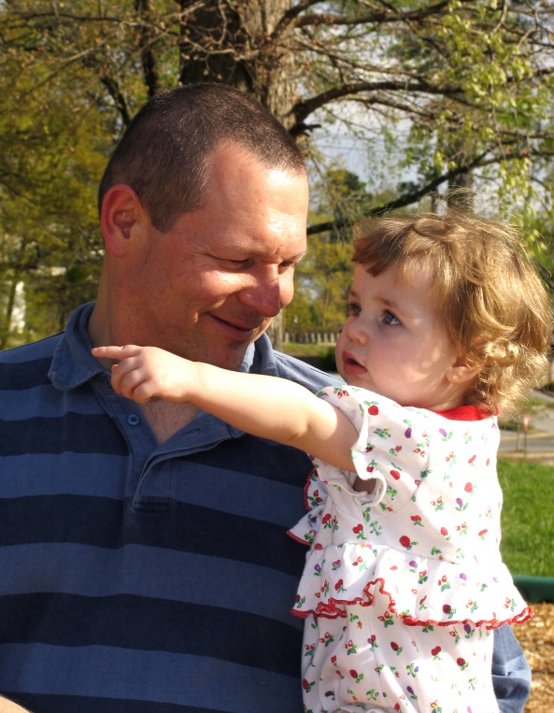

First Steps Legislative Goals
Act 287. Section 59-152-30.
(1) provide parents with access to the support they might seek and want to strengthen their families and to promote the optimal development of their preschool children;
(2) increase comprehensive services so children have reduced risk for major physical, developmental, and learning problems;
(3) promote high quality preschool programs that provide a healthy environment that will promote normal growth and development;
(4) provide services so all children receive the protection, nutrition, and health care needed to thrive in the early years of life so they arrive at school ready to succeed; and
(5) mobilize communities to focus efforts on providing enhanced services to support families and their young children so as to enable every child to reach school healthy and ready to succeed.
Notes:
Facilitator Note: Briefly review legislative goals.

Slide 14
SC First Steps Structure
In each of South Carolina’s 46 counties, First Steps expands early learning services available for young children, their families, and caregivers.
All counties are served by a local First Steps partnership responsible for meeting local needs and identifying collaborative opportunities to help the state’s youngest learners.
State level board and staff support statewide priorities, programs, and assist local partnerships in meeting the needs of families statewide.
Notes:
Explain:
You will learn more about the structure of First Steps at the state level in the remainder of this training. The following training, Module 2: Local Partnership Structure & Function, will take you through the purpose of local partnerships and boards and what the local partnerships are responsible for, including the responsibilities of the Executive Director and board members.

Slide 15
SC First Steps Structure
State Board of Trustees
Section 59‑152‑40. “The South Carolina First Steps to School Readiness Board of Trustees established in Section 63‑11‑1720 shall oversee and be accountable for the South Carolina First Steps to School Readiness initiative.”
5 appointed by Governor, 4 by House Speaker, 4 by President Pro Tempore to represent categories (parents, early childhood, business, medical)
4 legislative members (Chair Senate Education, Chair House Education and Public Works, 2 gubernatorial appointees)
Governor or designee (Chair)
Superintendent of Education or designee
Agency/Organization Directors: DSS, DHEC, DHHS, DDSN, Head Start Collaboration Office, Children’s Trust

Slide 16
SC First Steps Structure
State Office of First Steps (SCFS)
Autonomous unit of state government within SC Dept. of Education
SCFS State Office Responsibilities:
Support 46 local non-profit partnerships by technical assistance, monitoring and accountability, managing finance and data system, and external evaluation
BabyNet lead agency (IDEA, Part C, 2010)
First Steps 4K Program in private settings statewide (2006)
Early Head Start-Child Care Partnership grantee (2015)
State office: Parents as Teachers
State coordinating office: Nurse-Family Partnership
Notes:
Facilitator Note: This is a general overview of the SCFS State Office responsibilities. More details on each of these responsibilities and programs will be provided at the end of this training and in future training modules.

Slide 17
SC First Steps State Office Duties
Section 59‑152‑50: “Under supervision of the South Carolina First Steps to School Readiness Board of Trustees, there is created an Office of South Carolina First Steps to School Readiness. The office shall:
Provide to the board information on best practice, successful strategies, model programs, and financing mechanisms;
Review the local partnerships’ plans and budgets in order to provide technical assistance and recommendations regarding local grant proposals and improvement in meeting statewide and local goals;
Provide technical assistance, consultation, and support to local partnerships to facilitate their success including, but not limited to, model programs, strategic planning, leadership development, best practice, successful strategies, collaboration, financing, and evaluation;
Notes:
Facilitator Note: These are the SC First Steps State Office Duties summarized from Act 287.

Slide 18
SC First Steps State Office Duties
Evaluate each program funded by the South Carolina First Steps to School Readiness Board of Trustees on a regular cycle to determine its effectiveness and whether it should continue to receive funding;
Recommend to the board the applicants meeting the criteria for First Steps partnerships and the grants to be awarded;
Submit an annual report to the board by December first;
Provide for ongoing data collection (including external evaluation schedule); and
Coordinate the First Steps to School Readiness initiative with all other state, federal, and local public and private efforts.

Slide 19
Structure of Local Partnerships
46 county partnerships
Local board and staff
501(c)3 nonprofit organizations
State funding via annual grant from SCFS, also leveraged by other public and private dollars
Program selection determined by local partnership board, approved by SCFS

Slide 20
SC First Steps Local Partnerships
How do Local Partnerships deliver services?
Each partnership identifies the community’s greatest school readiness needs and addresses them by:
Supporting or expanding existing services, such as funding a local school district’s early childhood program.
Contracting for added services, such as children’s health screenings.
Directly providing services, such as parent education.

Slide 21
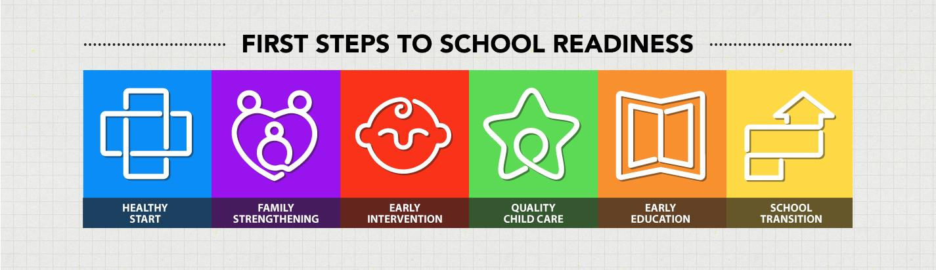
SC First Steps Core Areas of Service
In each county, First Steps expands early learning services available for young children, their families, and caregivers. Each of the six color blocks of the First Steps logo represents a core area of service, outlining a comprehensive strategy to prepare children for long-term school success.
Notes:
Facilitator Note: The next several slides aim to provide a general overview of SC First Steps Core Areas of Service and programs. They do not include every detail about each one. You may choose to add or remove slides in order to tailor the training to the areas of service offered by the particular local partnership that is the audience of the training.

Slide 22

SC First Steps Core Areas of Service
Heathy Start
Healthy Start programs are strategies with health outcomes as a primary focus. These include health services such as includes prenatal and post-partum services for both mother and baby.
  Nurse-Family Partnership
Notes:
Explain:
The Nurse Family Partnership (NFP) program, an evidence-based initiative, was established in South Carolina in 2007 as a partnership between First Steps and The Duke Endowment. Now entering its eighth year of implementation, NFP is a collaborative effort of multiple state and local partners including First Steps (the state sponsor agency), The Duke Endowment, the BlueCross/BlueShield Foundation of South Carolina, The Children’s Trust and the Department of Health and Environmental Control (DHEC). As of 2014, the program operates in more than 20 South Carolina counties and is supported by the Office of First Steps at the state-level, and where so approved by local partnership boards, at the county-level. The program model requires frequent home visits to first time mothers, starting during pregnancy and continuing through the first two years of the child’s life. Home visits are provided by nurses and provide an opportunity for vulnerable mothers to receive inhome support.

Slide 23

SC First Steps Core Areas of Service
Family Strengthening
Family Strengthening programs support parents and other adult family members as their child’s first teacher. First Steps partnerships fund several types of family strengthening programs:
  Home Visitation
  Family Literacy
  Dolly Parton Imagination Library
  Parent Training and Other Family Literacy
  and Supports
Notes:
Explain:
Family Strengthening programs are important for facilitating long-term sustainable changes in family functioning—benefits that can continue to generate value into the future and over the course of a child’s educational career. Further, Family Strengthening programs commonly generate benefits for young children as well as for their siblings and other family members.
Home Visitation programs include Parents as Teachers, Nurse-Family Partnership, Parent-Child Home, and Early Steps to School Success.
Parents as Teachers is a nationally recognized model for providing family and parenting support, and is the most prevalent Family Strengthening program directly supported by local partnerships.
Nurse-Family Partnership
Family Literacy Programs are based on a model of adult education, early childhood education, parenting education, and parent-child interaction. Literacy programs often provide children with developmentally appropriate books and teach parents how to engage with their children in reading or literacy-supporting activities—which has the added benefit of promoting constructive parent-child interactions.
Dolly Parton Imagination Library is a program that gives children a free book each month from birth up until 5 years old
Parent Training and Other Family Literacy and Support includes programs such as MotherRead, Reach Out and Read, Raising a Reader, Incredible Years, Triple P, Library-based Programs, Fatherhood, and other locally-developed programs

Slide 24

SC First Steps Core Areas of Service
Early Intervention
Finding and serving children with developmental delays as early as possible can reduce later remediation and can help children prepare for school success along with their typically developing peers.
  Early Identification and Referral
  BabyNet
Notes:
Explain:
Early Identification and Referral was created in 2012 to support local BabyNet offices by serving as the local Child Find entity, screening and referring children to BabyNet, and connecting non-eligible children to needed services that may respond to the child (and family’s) needs. Further, local partnerships often elect to fund Early Identification and Referral (EIR) strategies (a First Steps prevalent program) to increase the number of young children identified with developmental delays or special learning needs..

Slide 25

SC First Steps Core Areas of Service
Quality Child Care
First Steps recognizes quality child care as a research-based determinant of school readiness. As such, First Steps collaborates with parents, the child care community and its agency and community partners to maximize child care quality throughout the state. Child care quality strategies fall into three major areas:
Quality Enhancement
Staff Training and Development
Child Care Scholarships
Notes:
Explain:
Quality Enhancement – First Steps assists child care providers to improve program quality by funding targeted upgrades to meet DSS licensing or ABC-enhanced requirements, and to further enhance learning environments for young children.
Staff Training and Development – First Steps provides staff development and mentoring to assist providers in meeting DSS training requirements, increasing the knowledge of child care workers and improving the quality of programs offered in participating child care facilities.
Child Care Scholarships – First Steps provides scholarships to high quality child care programs for eligible families and their children and increases the number of child care slots in South Carolina.

Slide 26

SC First Steps Core Areas of Service
Early Education
First Steps leverages state, local and private resources to increase the quality of, and number of children participating in, developmentally appropriate pre-kindergarten programs in both the public and private sectors. Early education strategies fall into the following types:
Expanding 4K in public schools: adding additional full-day 4K classrooms, extending half-day programs to full-day, or providing preschool to children under 4 (i.e. 3K).
Early Head Start
Notes:
Explain:
First Steps’ efforts to improve early education opportunities for young children in South Carolina include:
Partnership Pre-K Expansion – Through its network of local partnerships, First Steps also works to expand high-quality preschool access in communities statewide. In some cases First Steps assists school districts to expand Pre-K offerings or to expand half-day programs to full-day. In other communities, partnerships work with private and non-profit partners to expand and improve preschool offerings in non-district settings.
Early Head Start – The First Steps Partnerships in Richland and Spartanburg Counties are federal Early Head Start grantees.

Slide 27

SC First Steps Core Areas of Service
School Transition
These services help children and families make the important transition into public school.
Countdown to Kindergarten is a home visitation program pairing the families of high-risk rising kindergartners with their future teachers during the summer before school entry. Teachers complete six visits with each family, centered upon classroom and content expectations.
Notes:
Explain:
Countdown to Kindergarten is designed to:
Establish lasting home-school bonds rooting in mutual respect
Enable parents and teachers to reach common understandings of both familial and classroom expectations for the coming school year; and
Establish strong student-teacher relationships that will facilitate the home-school transition and enhance classroom learning.

Slide 28
SC First Steps State-Level Programs

Slide 29

BabyNet
South Carolina’s early intervention system for children birth-36 months with developmental delays or disabilities
Funded by IDEA Part C, state, Medicaid, private insurance
SC First Steps became lead agency in 2010 and system point of entry (SPOE) agency in 2011
Direct services provided by DDSN, local DDSN boards, SC School for Deaf and Blind, 1,000+ private providers

Slide 30
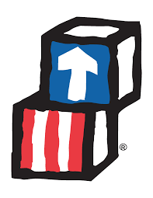
Early Head Start
The federal Early Head Start – Child Care Partnerships initiative was created to expand Early Head Start services within infant-toddler child care settings.
Beginning in 2016, First Steps will contract with a limited number of providers within a defined twelve county service area, including the counties of Allendale, Anderson, Bamberg, Berkeley, Dillon, Georgetown, Laurens, Lexington, Newberry, Orangeburg, Saluda, and York
Notes:
Explain:
Early Head Start is a complement to the Head Start preschool program serving low-income families with infants and toddlers and pregnant women; designed to: 1) promote the development of young children, 2) engage parents in their roles as primary caregivers and teachers, and 3) help parents move toward self-sufficiency. Early Head Start is a full-day (minimum 6 hours), full-year (5 days per week, 48 weeks per year) comprehensive model, promoting the school readiness of low-income infants and toddlers (birth to third birthday).

Slide 31

First Steps 4K
(formerly CDEPP)
Permanently established by the SC Read to Succeed Act in 2014, the SC Child Early Reading Development and Education Program (CERDEP) provides full-day four-year-old-kindergarten programs in 64 South Carolina school districts.
SC First Steps 4K offers parents the opportunity to enroll their eligible children in more than 150 private, faith- and community-based preschool providers statewide at no cost to families.

Slide 32

Parents as Teachers (PAT)
PAT is a national, evidence-based home visitation model designed to ensure young children are healthy, safe, and ready to learn.
SC First Steps has served as the lead agency for PAT in South Carolina since 2011.
SC First Steps provides technical assistance, training and support to each of the state’s 43 affiliate PAT programs.

Slide 33
Training Modules for SC First Steps Local Partnership Orientation
Module 1: Orientation - What is SC First Steps?
Module 2: Local Partnership Structure & Function
Module 3: Local Partnership Systems and Accountability
  Supplemental Systems & Accountability Modules
Your SC First Steps Partnership
Notes:
Explain:
The next training session is Module #2: Local Partnership Structure and Function. In this module, new partnership staff will learn about the purpose of local partnerships and boards and what the local partnerships are responsible for, including the responsibilities of the Executive Director and board members.

