Slide 1
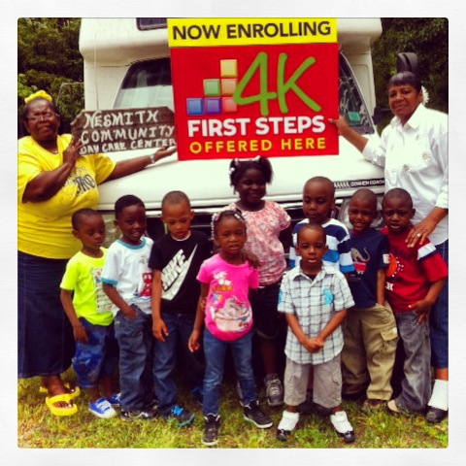
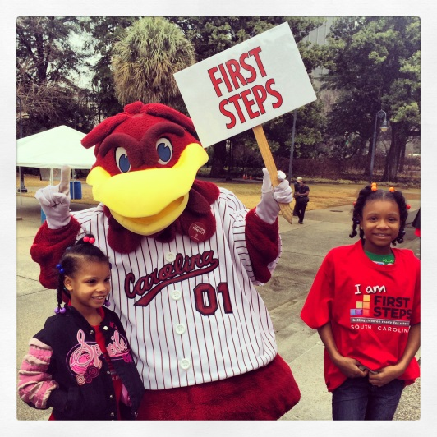
April Leadership
Webinar
April 24, 2015
10:00-11:30am
To access this meeting by voice, please dial 888-537-7715,
participant code 52045398#

Slide 2
Today’s Agenda
Welcome and introductions
Legislative Update
April 14th Board to Board – Take Aways
FY 16 Renewal
Next Steps –Partnership Site Visit/Interview
6. First Steps Strategic Planning Update
7. 4-K Update
8. Baby Net Update
9. Week of the Young Child Highlights
10. Announcements/ Key dates

Slide 3
April 14th Board to Board
Dr. Tammy Palowski Presentation regarding Serving and Finding At Risk children and Families
Attorney overview of First Steps’ new law (Act 287) and by-law changes
Cherokee Collaboration- Talk to Me
Break out groups sharing information regarding successes and 3 core functions

Slide 4
FY 16 Renewal and Beyond
April 30 –Data entry completed (as much as possible)
May 8 - Final date for FY 16 Renewal Plan submission
June 1– Data entry deadline for renewal plan review
June 18–SC First Steps Board of Trustees review and renewal plan approval
May 26 through July 31 – Consultation/Site Visits
August 20 – State Board Meeting – Strategic Plan

Slide 5
CARRY FORWARD
FY14 Carry Forward:
Make sure all FY14 carry forward is budgeted in your current BSP in Fund 11
Spend by June 30!
FY15 Carry Forward:
Do not budget FY15 carry forward (Fund 56) in your Renewal BSP
Finance Office will certify available carry-forward per partnership by October 15.
Partnerships with FY 15 carry-forward exceeding 15% of their FY16 state allocation must submit a written justification and plan to reduce their amount of carry-forward to 15% or lower by the following fiscal year (FY17).
Partnerships whose carry-forward exceeds 15% for two or more fiscal years will be subject to conditional approval and potential withholding of grant funds at the discretion of the First Steps Board of Trustees

Slide 6
PARTNERSHIP Reflection and Planning 2015-16
1. Offer on-site, consultative technical assistance directed by needs and strengths of each local partnership.
2. Provide a venue for two-way communication –see local programs first hand / offer information on state planning efforts.
3. Gather data to inform the statewide strategic plan.
4. Jointly identify key focus for TA support of local partnership needs for FY 16.
5. Connect directly with local board members and staff.

Slide 7
Three Step Process
Initial Partnership Review Preparation and Interview (May 26 -July 31)
Draft Priority Partnership Goals (by August 31)
Partnership Board Approved Priority Goals Submitted (by September 30)

Slide 8
Initial Partnership Review Preparation and Interview
Interview team will consist of partnership TA, additional state office staff, state board member
Include at least one partnership board member, plus other staff and vendors (as feasible)
Interview preparation questions will be released next week (Partnership Reflection and Planning template)

Slide 9
Partnership Reflection and Planning interview template
Successes and challenges:
Overall
By Strategy (implementation, results)
Governance and Operations, Fiscal, Collaboration/Community Engagement, Resource Development
Effectiveness with:
Finding/serving at-risk children
Collaboration around community needs
Increasing access
Training/Development Needs of Partnership (board and staff)
Core Functions

Slide 10
Priority Goals
Local partnerships develop from reflection interview results, in consultation with TA
Prioritized based on compliance with partnership and program standards, serving at-risk children, increasing access and quality
Draft due Aug. 31 using Priority Goals template
Board-approved goals due Sept. 30
Serves as CQI Plan for FY16

Slide 11
FY16 Partnership TA Assignments
Linda Leonard
Barnwell
Berkeley
Charleston
Dillon
Dorchester
Georgetown
Horry
Orangeburg
Williamsburg

Slide 12
FY16 Partnership TA Assignments
Mary Anne Mathews
Beaufort
Darlington
Florence
Marion
Fairfield
Jasper
Kershaw
Marlboro
McCormick
Union

Slide 13
FY16 Partnership TA Assignments
Betty Gardiner
Abbeville
Aiken
Calhoun
Clarendon
Edgefield
Greenwood
Lexington
Richland
Sumter

Slide 14
FY16 Partnership TA Assignments
Janice Kilburn
Anderson
Greenville
Lancaster
Laurens
Newberry
Oconee
Pickens
Spartanburg
York

Slide 15
FY16 Partnership TA Assignments
Debbie Robertson
Allendale
Bamberg
Cherokee
Chester
Chesterfield
Colleton
Hampton
Lee
Saluda

Slide 16
4K UPDATE
Academy 2015, July 27-31 in Columbia
~All partnership EDs and TAs are invited~
Current Outreach to EDs and potential centers
Anticipate 64 eligible districts for 2015-2016, with addition of Anderson 2, Anderson 5 and Kershaw (based on most recent demographic data). Senate finance budget does not include additional geographic expansion or funding.
Circle End of Year Assessment, April 15- May 15
Results from 4K Parent, Teacher and Director Surveys

Slide 17
Circle Survey: Parents
95% of parents surveyed report seeing improvement or great improvement in their CHILDREN’S LITERACY KNOWLEDGE during 2014-2015.
90% of parents surveyed reported finding the CIRCLE PARENT REPORT helpful or very helpful.

Slide 18
Circle Survey: Teachers
88% of teachers surveyed report finding the Circle helpful or extremely helpful in PLANNING FOR THEIR STUDENTS’ LEARNING NEEDS.
89% of teachers surveyed reported doing more or much more LITERACY INSTRUCTION as a result of the Circle.
89% of teachers surveyed found Circle useful or very useful in COMMUNICATING THE LEARNING NEEDS OF THEIR STUDENTS TO PARENTS.
96% of teachers using Circle reported seeing improvement or significant improvement in the LITERACY KNOWLEDGE OF THEIR STUDENTS.

Slide 19
Circle Survey: Directors
89% of directors surveyed report finding the Circle helpful or extremely helpful in PLANNING FOR THEIR STUDENTS’ LEARNING NEEDS.
91% of directors surveyed reported that their teachers are doing more or much more LITERACY INSTRUCTION as a result of the Circle.
94% of directors surveyed found Circle useful or very useful in COMMUNICATING THE LEARNING NEEDS OF THEIR STUDENTS TO PARENTS.
95% of directors using Circle at their schools reported seeing improvement or significant improvement in the LITERACY INSTRUCTION OF THEIR TEACHERS.

Slide 20
4K Regional Coordinators
Barbara Black (Richland, Chester, York, Kershaw) bfblack@scfirststeps.org
Anthony Broughton (Barnwell, Bamberg, Newberry, Calhoun, Sumter, Allendale) abroughton@scfirststeps.org
LaDrica Christian (Florence, Darlington, Lee, Williamsburg, Dillon) lchristian@scfirststeps.org
Kristine Jenkins (Horry, Marion) kjenkins@scfirststeps.org

Slide 21
4K Regional Coordinators
Cassandra Johnson (Spartanburg, Laurens, Anderson, Cherokee, Union, Oconee, Anderson) cjohnson@scfirststeps.org
Joy Mazur (Berkeley, Orangeburg, Georgetown, Hampton, Clarendon, Colleton) Jasper-jmazur@scfirststeps.org
Marley Via (Lexington, Aiken, Edgefield, Saluda, Greenwood) mvia@scfirststeps.org
Martha Strickland- Director mstrickland@scfirststeps.org, 803-394-3446

Slide 22
BabyNet Update
Annual grant renewal submitted to U.S. Department of Education this week.
Working with providers and interagency partners to fine tune BRIDGES data system.
If you are not in regular contact with regional BabyNet staff and/or need support with local issues, please contact Debbie and/or Christie Duke at 803-734-4713. It is important to us that BabyNet work hand in hand with the Partnerships.

Slide 23
ANNOUNCEMENTS
HIGHLIGHTS
NAEYC's Week of the Young Child™ April 12 –18, 2015
Countdown to Kindergarten Planning
2015 Forms and Curriculum posted to website
Toolkit order forms past due
Training for CTK visitors
Executive Director Directory (ED Focus Group idea)
Other Announcements – news from the partnerships

Slide 24
Summer 2015 Calendar
May 26 -July 31 Partnership Interviews/Site Visits
May 29 SC First Steps Board of Trustees Meeting
June 18 SC First Steps Board of Trustees Meeting
July 27–31 4K Academy (Columbia)
August 20 SC First Steps Board of Trustees Meeting

