Slide 1
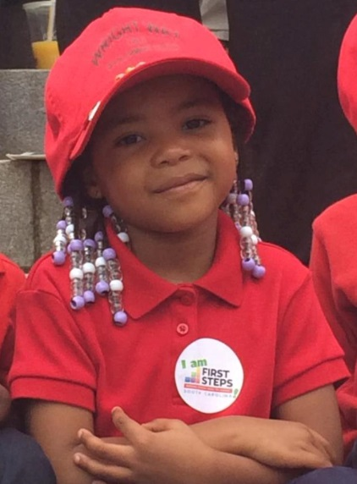
Countdown to Kindergarten
Teacher Training

Slide 2
AGENDA
Welcome & Introductions
Program History & Description
Administrative Requirements
Safety
Curriculum, Tool Kit, & Tips
Questions, Answers, & Next Steps
Adjourn

Slide 3
What is Countdown to Kindergarten?
Countdown to Kindergarten (CTK) is a First Steps program based on other successful school transition models from around the country. Its goals are:
to increase the successful transition of South Carolina’s most at-risk children into the K-12 school system;
to increase parent involvement in the early grades (particularly in hard-to-reach communities), when children’s learning is foundational for life success; and
to increase public awareness of the importance of school readiness and provide ways for parents and communities to impact children’s early school success.

Slide 4
What is Countdown to Kindergarten?
Home Visitation. Teachers make six visits over the summer to the homes of participating students and families. Visits are hour-long sessions whereby children and families are introduced to actual materials used in kindergarten and are given a Kindergarten Transition Toolkit (backpack filled with books, puzzles, clay, blocks, etc.) to keep.
Learning Celebration. The last visit is a “field trip” to the school where the child will attend class in the fall. Early in August a CTK Celebration is planned to host the children and their families to a meal and celebration of their child’s accomplishment. We build on their excitement by providing additional school supplies and books for the children and help the parents learn about other community resources to help their children excel in their efforts.
Public Awareness. Throughout the summer, First Steps releases tips to statewide media to help parents and caregivers get children ready for kindergarten.

Slide 5
The History of Countdown to Kindergarten
CTK is 13 years old this year!
Over 10,000 children state-wide have participated.
Program was developed in South Carolina and is a nationally recognized model.

Slide 6
How do you get paid?
1st – Memorandum of Agreement & Confidentiality Form
(Refer to local First Steps office for direction on who you contact)
2nd – W-9 form (Refer to local First Steps office for direction on who you contact)
3rd – Invoice
Visit Stipend & Mileage on the same form (This may vary by county partnership)
Electronic version of the form will be emailed to you
$______ for completed visits (Mileage Info-based on your county partnership agreement or school district agreement)
JUNE VISITS – Invoice due BY JULY 7th
JULY/AUGUST VISITS – Invoice & ALL REQUIRED FORMS due by AUGUST 15th.

Slide 7
Teacher Survey
Completing the teacher survey is required.
Must be completed 9 weeks after school starts
Specific survey information will be sent to you after the start of school from the State Office

Slide 8
What should I have to connect with Countdown Families?
Countdown Curriculum
One set of parent handouts for each family
Transition Toolkit
Enrollment Forms
Family Information Sheet
Consent & Authorization Form
Privacy Statement
Family Eligibility Determination Form
A Pre and Post Family Questionnaire
Documentation of home visits made and mileage

Slide 9
For Your Safety
Your safety is most important.
It is a HOME Visitation Program.
Things to consider:
Speak with 4k teacher that may have already visited the family before to gain insight.
Drive by the home prior to the first visit to familiarize yourself with the area. Notice your surroundings and whether or not there is adequate cellular coverage.
Consider asking a school administrator to attend the first visit with you.
Leave a schedule of where you will be and when you should be expected to return with a family member/school/friend.

Slide 10
The DO’s to Countdown to Kindergarten
Focus on the family; get involved with them
Have a positive attitude about being there and you will enjoy your visits
Find and build on the positive aspects of the family
Be a good listener
Be flexible
Be prompt
Use professional language
Dress appropriately and comfortably

Slide 11
The DO’s to Countdown to Kindergarten
Be confident
Be yourself
Respect cultural and ethnic values
Monitor your own behavior-the parent is observing you
Use common sense to maintain your safety
Each time ask the parent/child if they have any questions

Slide 12
What Not to do in Countdown to Kindergarten
Impose your own values
Exclude other members of the family from the visit
Discuss other families in your program
Be the center of attention.
Expect perfection from the parent
Act as if it is an academic program.

Slide 13
Tips for Successful Visits
Carry extra stories in your bag to read to the children.
Let your family members know the schedule. (Commitment form)
Take everything out of the toolkit except art supplies and keep until each lesson (like taking a “gift” each time you go). Leave the family with the backpack and art supplies.

Slide 14
Pre & Post Questionnaires
The home visitor administers the Pre Questionnaire to the parent/guardian of the CTK student during the first home visit.
The home visitor administers the Post Questionnaire to the parent/guardian of the CTK student during the fifth or sixth visit.
The home visitor should assign each family an individual family number (no family should have the same number as another family) for the Pre and Post Questionnaires.
This identification system ensures each family’s survey remains anonymous, yet allows a family’s Pre and Post Questionnaire’s to be evaluated.

Slide 15
Pre & Post Parent Survey
The Parent Surveys (Pre and Post) are critical to measure program success.
Pre Survey- 1st visit
Post Survey – 6th visit
Parents have the option to take both surveys online or may complete a hard copy.
After the Pre and Post Questionnaires have been completed, please submit both forms to your local First Steps County Partnership.

Slide 16
Visit 1- Getting to Know You
Set up all visits, write them on the family commitment form as well as your calendar – emphasize the parent/caregiver’s role in the visits
Leave a telephone number
Complete family information sheet, consent/media form, & Pre Parent Survey. Assign family number on form. This remains confidential.
As you are sharing the toolkit with the child and parent remind them to keep everything together until the end of the program
During this lesson use the crayons and writing journal to draw a self portrait
Share a me box/bag and ask the child to make one for the next visit
Record the visit on the Record of Home Visits Form

Slide 17
Visit 2- Language Arts
At this visit take cookie sheet to use for a magnetic board
Bring ABC stickers (or sticker dots) to use for an art project
After reading the story use the art materials to make a coconut tree and put ABC stickers on it
Use the play dough to make letters of the alphabet (on the cookie sheet)
Record the visit on the Record of Home Visits Form

Slide 18
Visit 3- Math
Use the materials to work on math standards (measurement, counting, sorting, and patterning)
After the child creates a pattern have him/her use the crayons to reproduce it in the writing journal
Use the construction paper and cut squares to match the pattern and glue them into the writing journal
After the puzzle use the play dough to make numbers and show them how to write them in the writing journal
Record the visit on the Record of Home Visits Form

Slide 19
Visit 4- Science
Talk about our five senses and look through a magazine to find pictures of things we can see, smell, touch, taste, and hear. Cut and glue them into the writing journal
Take a bag of objects that you and the child can explore using the magnifying glass.
Read the story- Brown Bear Brown Bear, talk about “five senses” and describe how we use our sense of sight to see
After reading the story we talk about “favorite character” and we draw it in the writing journal
Record the visit on the Record of Home Visits Form

Slide 20
Visit 5- Social Studies & Writing
Read any story relating to week 5 topics as they may pertain to how we are alike and different and when we get to school how we will learn to make good choices at school, learn to be safe, and get along with each other.
Give each child a dry erase board and marker and use it to practice writing his/her name, letters, and/or numbers.
During this lesson discuss how we will learn how to get along with each other
Review the materials from the toolkit with the child/parent to use the rest of the summer
Record the visit on the Record of Home Visits Form

Slide 21
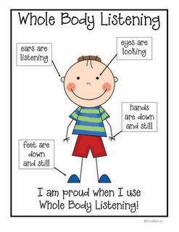

Slide 22
Visit 6- Classroom Visit
Can be completed as a group of Countdown to Kindergarten students and families.
Invite administrators, guidance counselors, and librarian if they are available.
Use this time to answer questions the parents may have (lunch, bus schedules, etc.)
Give out registration materials (if principal approves).
Should be focused on the Countdown to Kindergarten children – not part of regular registration day.
Parent completes the Post Survey
Record the visit on the Record of Home Visits Form

Slide 23
Next Steps
Today
Sign MOA, Confidentiality Form, & W9
Pick-up toolkits, supplies, and notebooks
Next Week
Copies of MOA and excel invoice file will be emailed to you.
Begin scheduling visits – can begin as soon as school is out.
During Summer
Check email for information requests, etc.
Let your county partnership contact person know when 6th visit is planned (so they can arrange for pictures, etc. for newspaper).

Slide 24
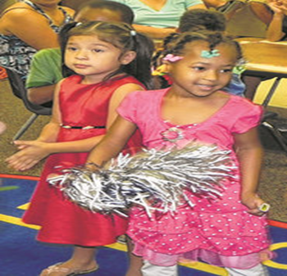
Remember…..
Effective teachers have a plan. If you don’t have a plan, then you’re planning to fail.
Always remember that home visits can be a significant resource in improving student academic and social achievement. You have your first ten students in CTK to make that difference. Enjoy your visits and be safe! ☺

Slide 25
QUESTIONS?

